Slide 1

Help Take-out
Tutor：Brian
  Team 17：
  Team leader： 12301091 陈兆阳
  Team member：12301102 李成一
  12301167 杨曦铭

Slide 2

Steps
  Description of prototype
  Demonstrate our app
  Describe the development of our app

Slide 3
Steps:
  Step 1.
  Description of prototype

Slide 4
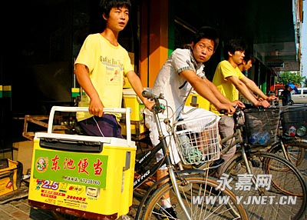
Step 1: Prototype

Slide 5
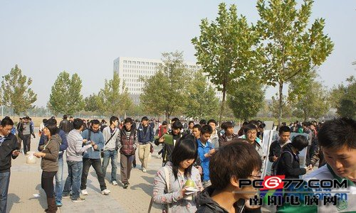
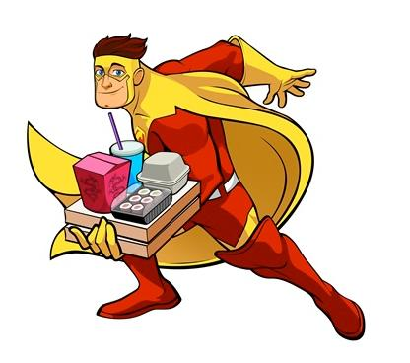
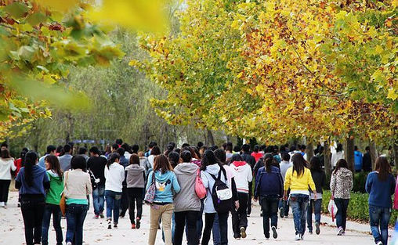
Step 1: Prototype

Slide 6
Steps:
  Step 2.
  Demonstrate our app

Slide 7
Step 2: Use case
Use case -Search for the order
Precondition-the user has logged in.
Description-The user clicks the search button, the app get user’s position info or let user to input their location, and search for the nearby order.
Post condition-The app show the list of order, sort by the distance. The info stores in local database.
Exception- If the user’s location get is wrong or the input cannot be found on the map, there is a reminder displaying that the info is wrong and let the user input again.

Slide 8
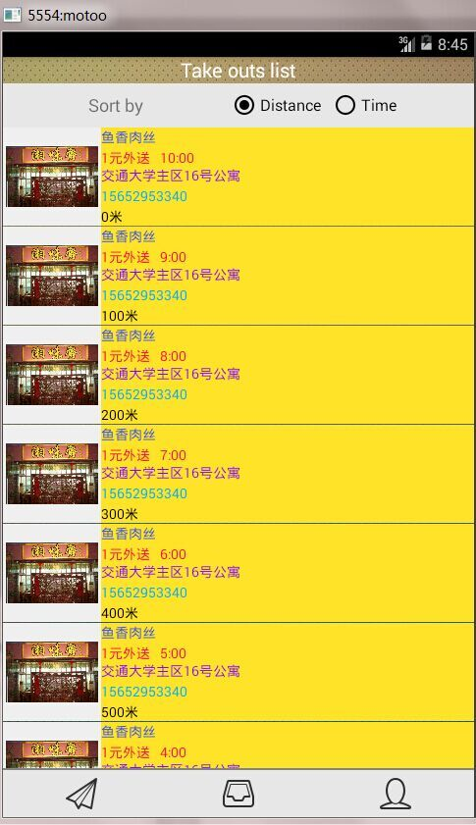
All those thing contained in one activity.
The page you have accepted but haven’t finished yet.
Personal information and your wallet.
Main list of all take outs you can find.
Three Image Button control Three Fragments e

Slide 9
Step 2: Use case
View details of the order
Precondition-The user has searched and got the list of order.
Description-The user clicks the order they want to see.
Post condition-The app shows the details of the order, include the restaurant’s name, the address of restaurant, the address of customer, the deliverables, and the delivery time.

Slide 10
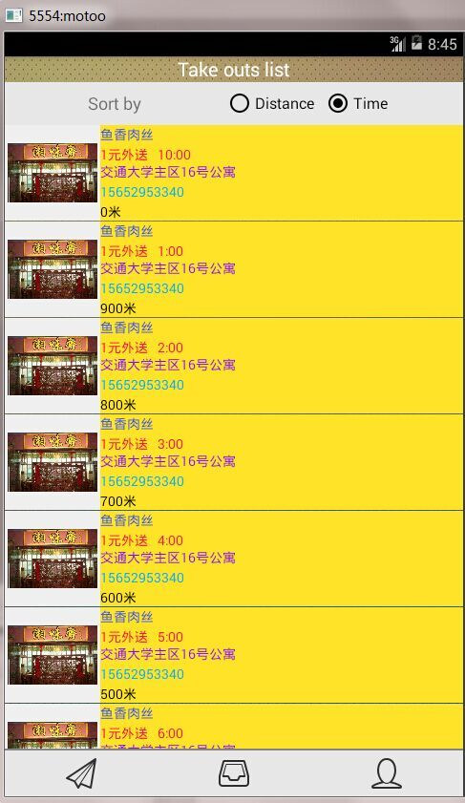
Changing sort by

Slide 11
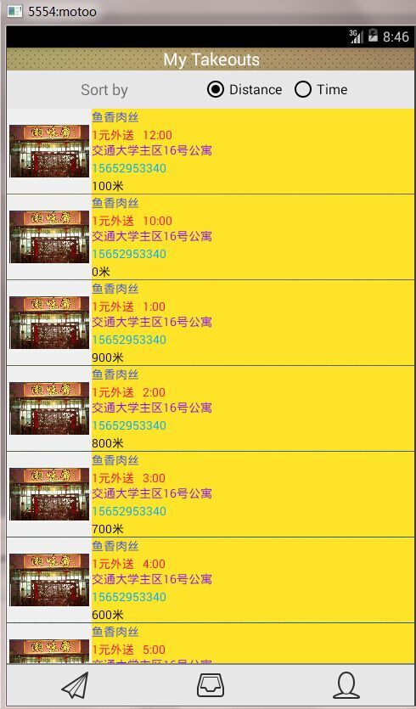
Click the item to add it in your list.

Slide 12
Step 2: Use case
Take order
Precondition-The user has logged in (The order is available)
Description-After the user view the details of the order, he could click the take order button.
Post condition- The user takes the order, and turns to the wait for the confirmation page. The info stores in local database.
Exception-If the order is taken by others, there is a reminder displaying that the order is taken by others and back to the search page, then search again and show the list of order.
Confirm the order
Precondition-The user has took the order.
Description-Turn to “wait for confirmation” page. After the take-out was delivery to the customer, the customer give the verification code to the user. The user input the verification code and click the confirm button.

Slide 13
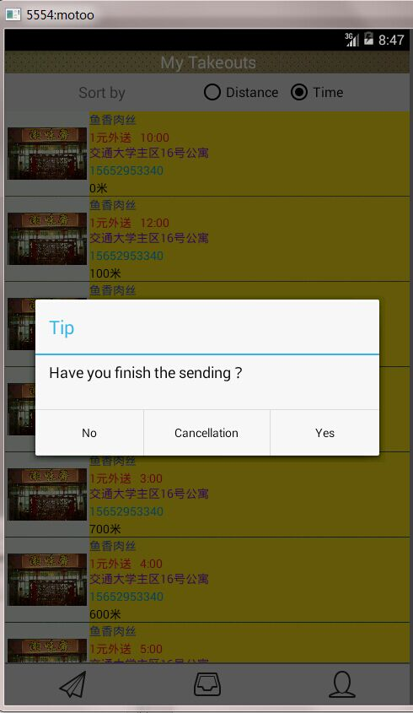

Slide 14
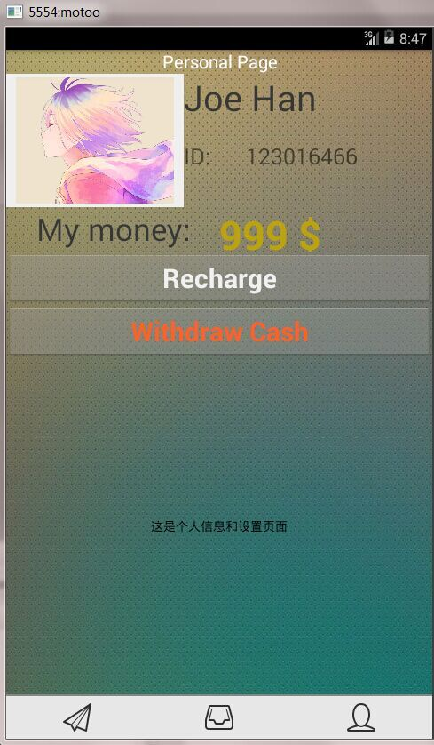
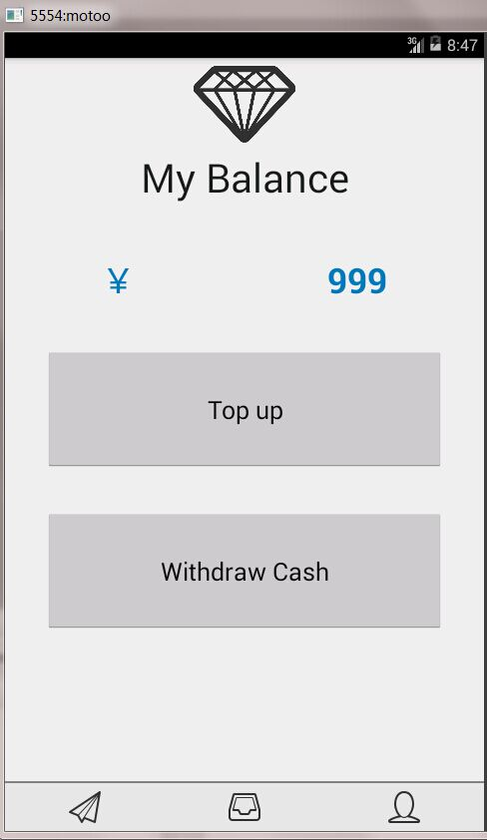

Slide 15
Steps:
  Step 3.
  The development of our app

Slide 16
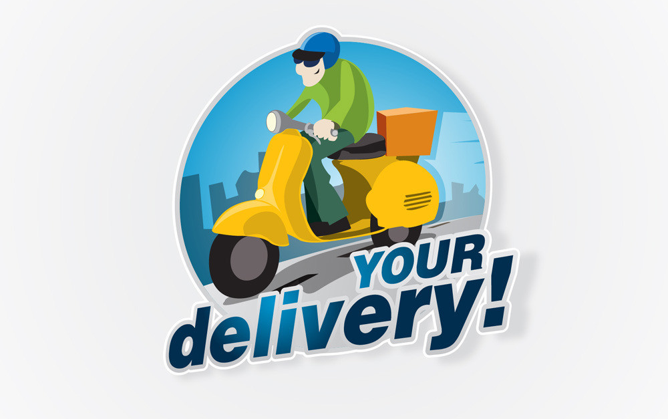
Step 3: Development
Help Take-out?
No!

Slide 17

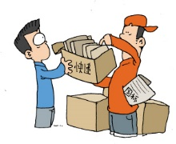
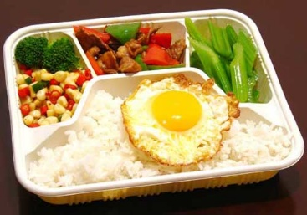
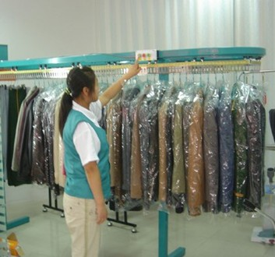
Step 3: Development
  Send goods
  Food & drinks
  Pick up cloth

Slide 18
In the end
  Thanks for waiting ……

